Slide 1

Sales & Profit Dashboard Summary Tableau Dashboard by Debabrata Mondal (05/06/2025)

Slide 2

Objective:
Design an interactive dashboard using Tableau to help business stakeholders understand sales and profit performance.

Slide 3
Tools & Dataset
Tools Used: Tableau
Dataset: Superstore Dataset (Kaggle)
KPI Used:
Total Sales
Total Profit
Total Orders

Slide 4

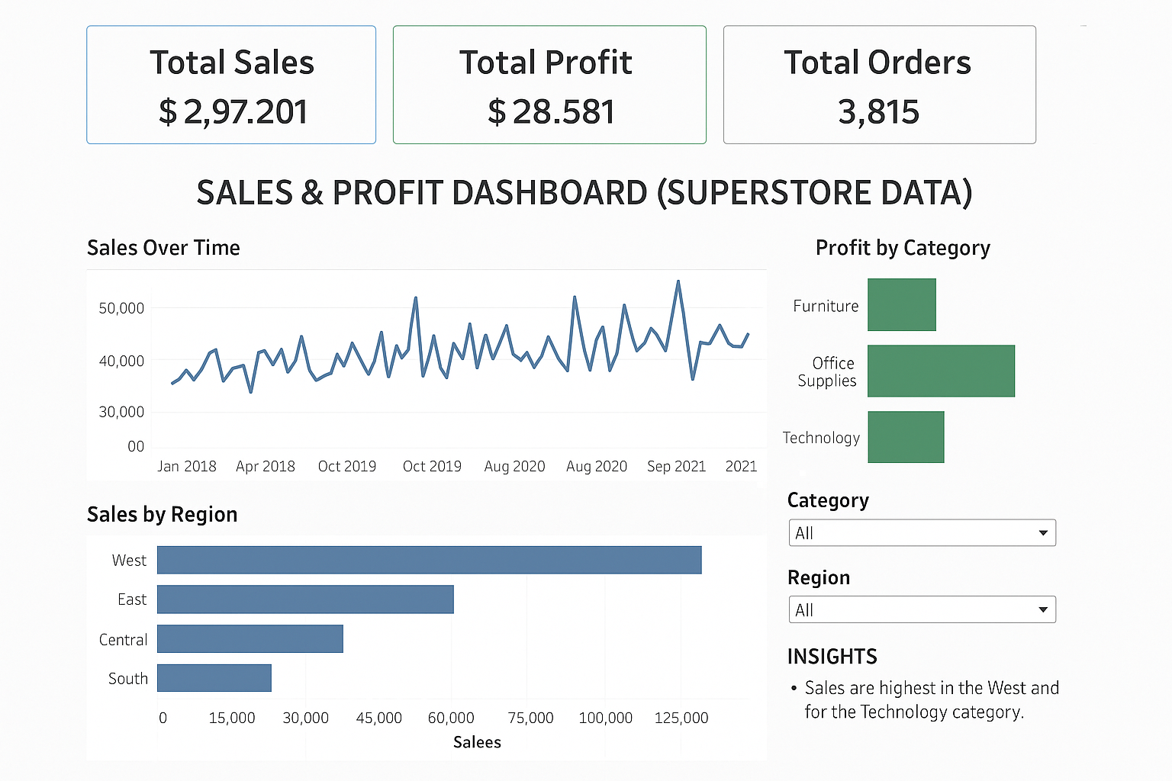
Final Interactive Dashboard Created in Tableau

Slide 5
Key Insights
Sales is highest in the West region.
Technology category contributes the most to profit.
Monthly sales trend shows consistent growth.

Slide 6
Features Used
KPI Cards for summary
Time-series Line Chart
Regional Bar Chart
Category-wise Profit Chart
Filters for Category and Region
Insight section added for clarity

Slide 7


